Slide 1
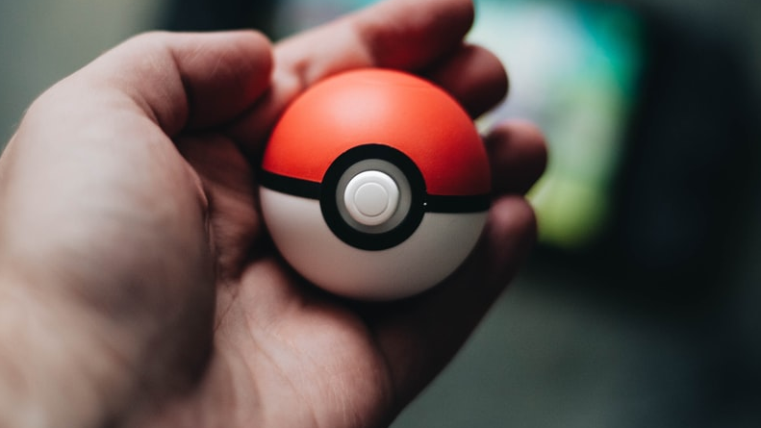
Who’s that Pokémon? (featuring Neural Networks)
A.I. image classification
Notes:
Kamil S from https://unsplash.com/

Slide 2
Introduction
Popular tcg, tournametns played for fun. Cards can sell for a lot.

Slide 3
Typing in names on phone is a clunky process.

Slide 4
Problem Statement
How can I build a program that can determine what Pokémon card it sees when it detects an image to help people catalogue their collections.
How do Neural networks learn patterns to identify images.
(how to improve accuracy on classification model with 151 classes)

Slide 5
Experiment Setup
Training

